Slide 1


Online Voting System
DHANUSH A 4MT21CS046
DHANUSH S SHETTY 4MT21CS047
GAUTHAM V 4MT21CS052
KARTHIK U SHETTIGAR 4MT21CS063
Under the guidance of
Mr. Shreejith K B
Asst. Professor,
Department of Computer Science and Engineering
Dept. of CSE,MITE

Slide 2
Mini-project
Contents
Introduction
Motivation of the Mini-Project
Literature Review
Research Papers Comparison
Objectives
Block Diagram and Flowcharts
Methodology
Conclusion
References
Dept. of CSE,MITE

Slide 3
Introduction
Mini-project
In the digital age, the integration of technology into various sectors has revolutionized traditional processes, enhancing efficiency, accessibility, and transparency. One such sector poised for transformation is the electoral process within academic institutions. This project aims to develop an "Online College Voting System" tailored for colleges and universities, providing a secure, user-friendly, and efficient platform for conducting student elections.
The traditional method of conducting college elections is often fraught with logistical challenges, time constraints, and security concerns. Physical voting booths require significant manpower and resources to manage, while manual vote counting can be prone to errors and manipulation. Furthermore, ensuring that all students have an equal opportunity to participate, regardless of their location or schedule, is a persistent challenge.
Dept. of CSE,MITE

Slide 4
Introduction
Mini-project
The Online College Voting System seeks to address these issues by leveraging modern web technologies to create a streamlined, accessible, and secure voting platform. This system will allow students to cast their votes from any location with internet access, ensuring greater participation and inclusivity. By incorporating robust authentication mechanisms and data encryption, the system will safeguard the integrity and confidentiality of the voting process.
Dept. of CSE,MITE

Slide 5
Motivation of the Mini-Project
Mini-project
Motivation for the Online College Voting System:
Traditional paper-based voting systems often encounter challenges such as low voter turnout, verification issues, and delays in result announcements. By developing an online voting system, we aim to address these issues and make the electoral process more convenient,secure, and inclusive. Our project's motivation lies in empowering students to actively participate in their governance by providing them with a user-friendly and accessible platform. Additionally, embracing modern technology not only improves the voting experience but also aligns with the digital age, fostering transparency, efficiency, and trusting our educational institution's democratic processes
Enhanced Accessibility and Participation:
Many students face logistical challenges in participating in on-campus elections due to class schedules, off-campus commitments, or physical disabilities. An online voting system ensures that all students can vote from any location, thereby increasing voter turnout and ensuring that every voice is heard.
Dept. of CSE,MITE

Slide 6
Motivation of the Mini-Project
Mini-project
Efficiency and Cost-Effectiveness:
Organizing traditional elections requires significant resources, including personnel, voting materials, and venue arrangements. By transitioning to an online platform, colleges can significantly reduce these costs. Moreover, the automation of vote counting and result tabulation speeds up the entire process, allowing for quick and reliable election outcomes.
.
Dept. of CSE,MITE

Slide 7
Literature Review
Mini-project
1. Security and privacy in smart city: A secure e-voting system based on blockchain - Fatima Zahrae Chentouf, SaidBouchkaren [1]This survey delves into blockchain's role in smart cities, highlighting its features of transparency, democracy, decentralization, and security, which can enhance safety and efficiency in urban settings. 2. Highly Secured Online Voting System over Network - K. P.Kaliyamurthie, R. Udayakumar, D. Parameswari and S. N.Mugunthan [2]The project's primary goal is to introduce an interactive online voting systemin India, enabling eligible voters to cast their ballots remotely. Registered voters receive a unique ID from the IECI and an online registration ID,ensuring dual authentication for secure access. 3. An Efficient Online Voting System – Ankit Anand, PallaviDivya [3]Traditional voting systems have transformed from manual to electronic, offering benefits but also facing drawbacks like inefficiency, paperwork, and limited accessibility. Online Voting Systems overcome these challenges, ensuring secure and convenient voting from anywhere, enhancing participation and safety.
Dept. of CSE,MITE

Slide 8
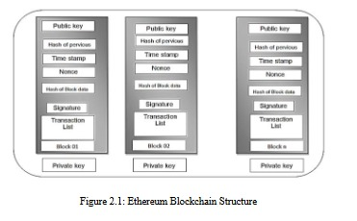
Literature Review
Mini-project
4. E-voting System Based on Ethereum Blockchain TechnologyUsing Ganache and Remix Environments – Hind S. Hassan,Rehab Hassan, Ekhlas K. Gbashi [4]A blockchain-based election system using smart contracts on Ethereumrevolutionizes voting. It offers decentralized, speedy, cost-effective, and securevoting, surpassing limitations of centralized systems.
Dept. of CSE,MITE

Slide 9
Literature Review
Mini-project
5. Online Voting System – Rajesh M. Ghadi, Priyanka S. Shelar[5]Online voting enables secure, convenient, and nationwide participation,reducing the fear of violence and increasing voter turnout. It offers a secure and efficient way to capture and tally votes.
Dept. of CSE,MITE

Slide 10
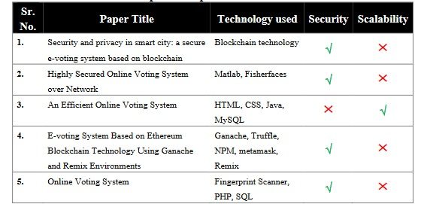
Research Papers Comparison
Mini-project
Dept. of CSE,MITE

Slide 11
Objectives
Mini-project
Development of a website for an Online College Voting System
To implement an automated vote counting system for each candidate and dynamically display the winners, we will use a combination of linear search and quick sort algorithms. The linear search algorithm will be employed to efficiently tally user votes by iterating through each vote and incrementing the count for the corresponding candidate. Once all votes have been collected, the quick sort algorithm will be utilized to sort the candidates based on their vote counts. This will allow us to dynamically display the winners.
Display the results through graphs and flowcharts
Dept. of CSE,MITE

Slide 12
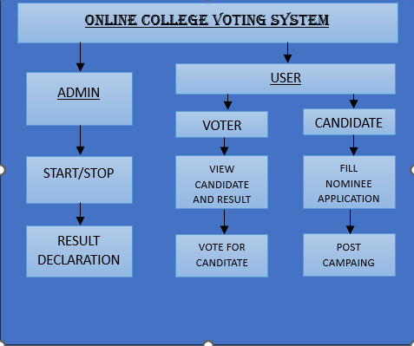
Block Diagram
Mini-project
Dept. of CSE,MITE

Slide 13
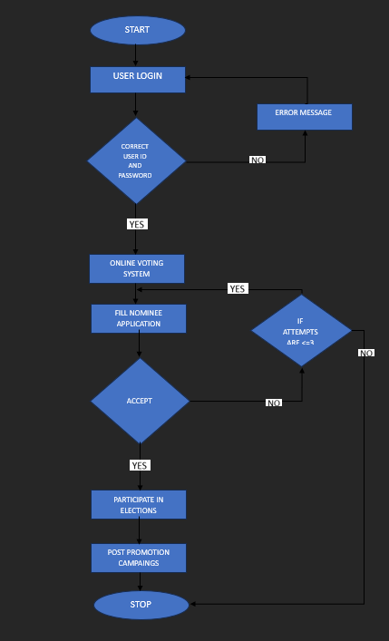
Voter login Flowchart:
Mini-project
Dept. of CSE,MITE

Slide 14
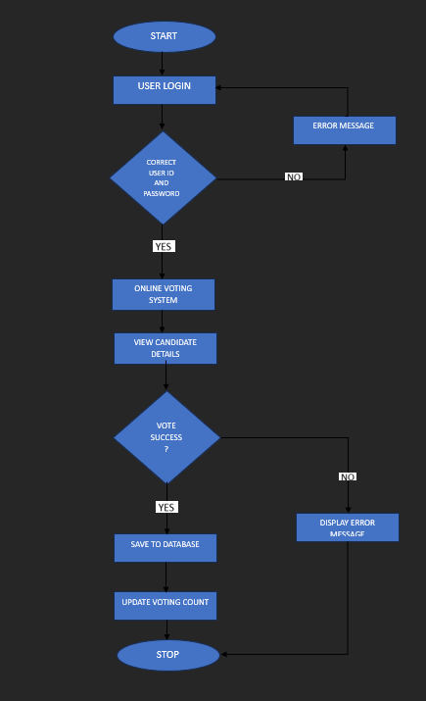
Candidate Flowchart:
Mini-project
Dept. of CSE,MITE

Slide 15
Methodology
Mini-project
Frontend Development: The frontend will be developed using HTML, CSS, and JavaScript to create a responsive and user-friendly interface for the Online College Voting System. The design will prioritize usability and accessibility across different devices, ensuring an intuitive voting experience for students.
Backend Development: The backend will be powered by PHP, integrated with the XAMPP stack, which includes Apache as the web server, MySQL as the database, and PHP for server-side scripting. This setup will leverage PHP's capabilities to manage user authentication, handle voting processes, and dynamically update results.
Database Management: MySQL, a relational database management system, will be utilized for storing student data, voting details, and election results. The XAMPP environment will provide a local server setup for development and testing purposes, ensuring efficient database management practices to maintain data integrity and facilitate quick information retrieval.
Dept. of CSE,MITE

Slide 16
Conclusion
Mini-project
The primary objective of the Online Voting System is to provide a user-friendly and easily accessible platform for voters to exercise their democratic right through the internet. In addition to enabling remote voting, this system significantly streamlines the vote counting process by harnessing the efficiency of database queries. Our system boasts seven pivotal characteristics that are fundamental to a robust Online Voting System. These include convenience, making it effortless for voters to participate,verifiability, ensuring the integrity of the electoral process; flexibility, adapting to varying election requirements; democracy, upholding the principles of fair representation; mobility, allowing voters to cast their ballots from anywhere; privacy,safe guarding voter data; and social acceptance, fostering trust and credibility. These attributes lay the foundation for the system's development, encompassing its analysis,design, implementation, and ongoing maintenance, ensuring that it aligns with the highest standards and stands ready to meet the diverse needs of voters and the democratic process alike
Dept. of CSE,MITE

Slide 17
References
Mini-project
[1] Fatima Zahrae Chentouf, Said Bouchkaren “Security and privacy in smart city: A secure e-voting system based on blockchain”, ERMIA Team, Department of Computer Science,ENSAT, Abdelmalek Essaadi University, Vol. 13, No. 2, April 2023,pp. 1848~1857 ISSN: 2088-8708, DOI: 10.11591/ijece.v13i2.pp1848-1857.
[2] K. P. Kaliyamurthie, R. Udayakumar, D. Parameswari and S.N. Mugunthan “Highly Secured Online Voting System over Network”, Deptartment of IT, Bharath University, Chennai,Jerusalem College of Engineering, Chennai, Vol 6 (6S) | May 2013.
[3] Ankit Anand, Pallavi Divya “An Efficient Online Voting System”, Department of Computer Science Engineering, BITSBhopal/ Rajiv Gandhi Technical University, Vol.2, Issue.4, July-Aug.2012 pp-2631-2634.
[4] Hind S. Hassan, Rehab Hassan, Ekhlas K. Gbashi “E-voting System Based on Ethereum Blockchain Technology Using Ganache and Remix Environments”, Computer Science Dept.,University of Technology-Iraq, Journal 41 (04) (2023) 562- 577.
Dept. of CSE,MITE

Slide 18
References
Mini-project
[5] Rajesh M. Ghadi, Priyanka S. Shelar “Online Voting System”, Dept. of Computer Engineering, Ideal Institute of Technology, Posheri, Volume: 04 Issue: 12 | Dec-2017.
[6] “Electronic Voting Machines”
[7] “Closed Envelope Ballot Voting”
[8] “Proxy Voting”
Dept. of CSE,MITE

Slide 19
THANK YOU

